Slide 1


DIALOGUE SUMMARIZATION
Group 25
Anudeep (2101AI43)
Sainadh (2101CS77)
Karthik (2101AI21)
Varshith (2101AI28)

Slide 2

TASK OVERVIEW
Task-1:Ground Truth Generation
Generate high-quality summaries for 1000–2000 dialogues from the BlendedSkill dataset
.
Task-2:Loss Calculation
Measure and reduce information loss in the summarization process.
.
Task-3: Response Generation
Build a chatbot that uses summary-based context to generate meaningful replies.
.

Slide 3
TASK 1

Slide 4
TASK-1 OVERVIEW
Objective: Ground Truth Generation to Perform Summarization .
Dataset: BlendedSkillTalk from Hugging Face
Methodology: LLM-based prompt engineering with Ollama model

Slide 5
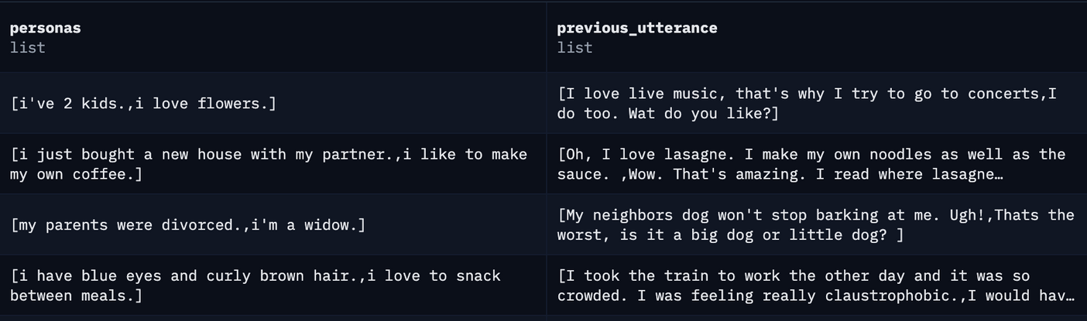
DATASET
Format: Each entry includes
personas: Descriptions of speakers
previous_utterance: Conversational history
Source: ParlAI/blended_skill_talk

Slide 6

METHODOLOGY
Prompt Construction
Designed a structured prompt including previous utterances and personas.
Ensured the prompt captures context for better summarization.
Summary Generation
Used Ollama LLM (LLaMA 3) for generating summaries.

Slide 7
TASK 1I

Slide 8
TASK OVERVIEW
Objective: Calculate and minimize the information loss in dialogue summarization.
Use State-of-the-Art (SOTA) summarization methods.
Measure loss and optimize the summarization process for better downstream response generation.

Slide 9
METHODS USED
Prompt Engineering
Zero-Shot, One-Shot, and Few-Shot Learning to guide the summarization process.
Fine Tuning
Fine Tune T5 base model.
Applying PEFT - Parameter Efficient Fine Tuning
Prompt Tuning
LoRA - Low Rank Adaptation to T5 base model

Slide 10

PROMPT ENGINEERING
Zero - Shot Prompt: The model performs a task without seeing any examples.
One - Shot Prompt: We give the model a single example of the task, followed by a new instance for it to solve.
Few - Shot Prompt: We provide the model with a few examples to learn the task pattern and style, followed by a new instance.

Slide 11
PROMPT ENGINEERING
Conversation to Summarize:
Person1: a radio dj, but not a music dj I dj for a talk radio station
Person2: Tell me more about the type of things you talk about -- topical issues? Politics? News stories?
Person1: when i retire i want to open a bakery
Person2: my family owned a small restaurant
Zero Shot Summary:
One Shot Summary:
Few Shot Summary:

Slide 12
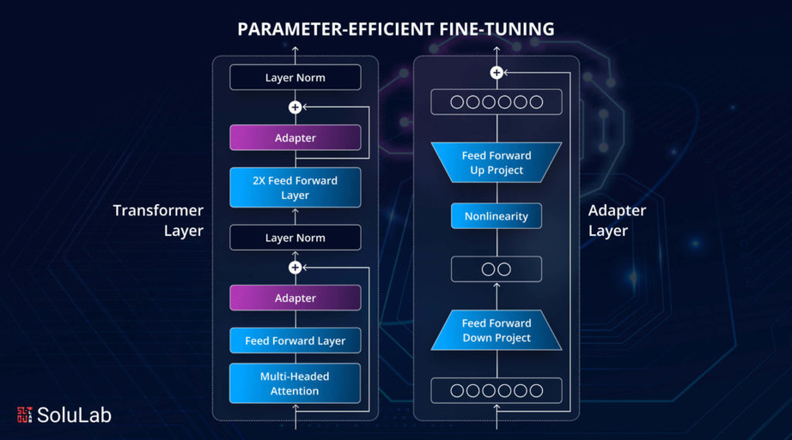
PEFT (PARAMETER EFFICIENT FINE TUNING)
PEFT is a fine-tuning method where only a small, selected set of parameters are trained while the majority of the model remains unchanged.
This makes the process lightweight and efficient for large language models.
Reduces computational cost and memory usage.
Allows efficient adaptation to new tasks with limited data.

Slide 13
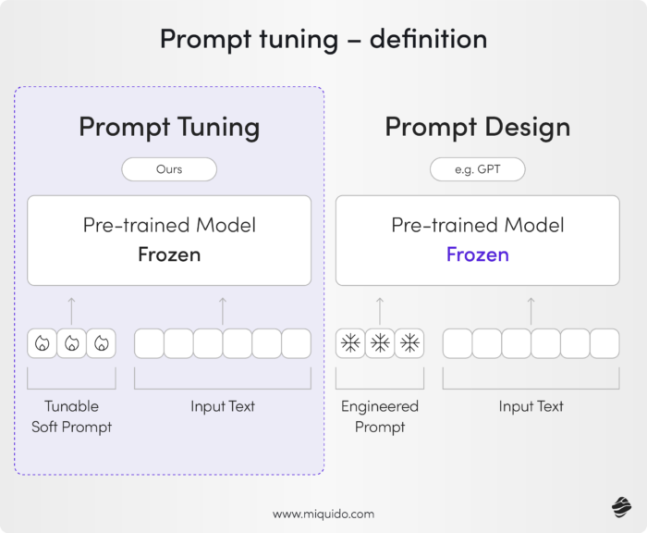
PROMPT TUNING
Prompt Tuning is a parameter-efficient fine-tuning method where a small set of learnable prompt embeddings (soft prompts) are trained and prepended to the input, while keeping the pre-trained model's weights frozen.
Trains only a small number of soft prompt tokens while keeping the original model frozen.
Learns task-adaptive prompts that guide the model to perform desired downstream tasks.

Slide 14
PROMPT TUNING
Conversation to Summarize:
Person1: a radio dj, but not a music dj I dj for a talk radio station
Person2: Tell me more about the type of things you talk about -- topical issues? Politics? News stories?
Person1: when i retire i want to open a bakery
Person2: my family owned a small restaurant

Slide 15
DIFFERENCE BETWEEN PROMPT TUNING AND PROMPT ENGINEERING
PROMPT TUNING
PROMPT ENGINEERING
Learnable, automatic (soft prompts)
Requires training to optimize prompts
Model remains frozen; only prompts are trained
Manual, human-written (text prompts)
No training; uses natural language inputs
No changes to model or its parameters

Slide 16
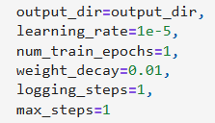
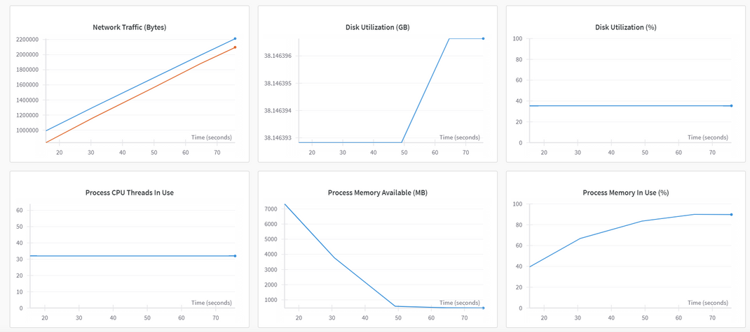
FINE TUNING T5 BASE MODEL
Tokenization
Used T5TokenizerFast from HuggingFace Transformers.
Applied padding and truncation to maintain uniform sequence lengths.
Training
Configured TrainingArguments as shown in the image.
Used HuggingFace Trainer API for streamlined model training and evaluation.
Integrated with WandB (Weights and Biases):
Log loss curves, hyperparameters, and model checkpoints.
Visualize training progress and monitor metrics in real-time

Slide 17
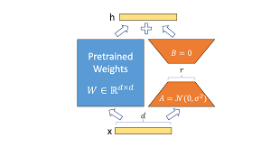
LORA (LOW RANK ADAPTATION)
LoRA is a technique under PEFT that introduces small trainable matrices into certain model layers, keeping the base model weights frozen.
This reduces the need to retrain the entire model for each new task
Only the added matrices are updated during training.
Enables fast fine-tuning without retraining the whole model.

Slide 18
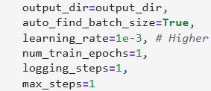
LORA FINE TUNING T5 BASE MODEL
LoRA Configuration
Used Low-Rank Adaptation (LoRA) to reduce the number of trainable parameters.
Injected lightweight trainable matrices into key attention layers ("q" and "v" modules).
Training
Configured TrainingArguments as shown in the image.
Used HuggingFace Trainer API for streamlined model training and evaluation.
LoRA allows higher learning rate.
Saved LoRA trainer and adapter for further use.

Slide 19

ADVANTAGES OF LORA OVER FULL FINE TUNING
Significant Parameter Reduction
LoRA only updates a small subset of parameters (e.g., rank r=32), keeping the base model frozen.
Drastically reduces memory and computational requirements.
Faster Training
Due to fewer trainable parameters, LoRA converges faster than full fine-tuning.
Enables efficient experimentation and iteration, especially on resource-constrained hardware.
LoRA Fine Tuning has only 1.41% of trainable parameters, when compared to Full Fine Tuning

Slide 20
LOSS CALCULATION METHOD
ROUGE Score: Measures overlap between generated summary and ground truth.
Higher ROUGE = less information loss.
ROUGE-1: Measures word-level (unigram) overlap.
ROUGE-2: Measures two-word (bigram) overlap.
ROUGE-L: Measures longest common subsequence.
ROUGE-Lsum: Measures summary-level sequence overlap.

Slide 21
ROUGE SCORE COMPARISON
Method | ROUGE-1 | ROUGE-2 | ROUGE-L | ROUGE-Lsum
Base model | 0.13009 | 0.02522 | 0.09618 | 0.09697
Instruct Model | 0.2165 | 0.05739 | 0.15601 | 0.15967
LoRA Fine-Tuned | 0.22227 | 0.07629 | 0.17078 | 0.17346

Slide 22
TASK 1II

Slide 23

SUMMARIZATION-AWARE CHATBOT USING T5 AND GPT-NEO
Objective
To create a chatbot that provides context-aware and concise responses by summarizing the ongoing conversation using LoRA Fine tuned T5 summarizer before passing it to GPT-Neo for response generation.

Slide 24
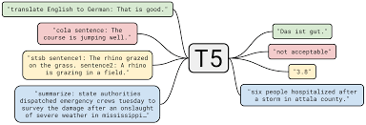
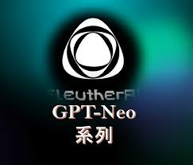
SUMMARIZATION-AWARE CHATBOT USING T5 AND GPT-NEO
Key Components:
T5 Model (Summarizer):
LoRA fine-tuned T5 model trained in the previous task
Extracts essential information from the entire chat history. Helps reduce token usage while preserving conversational context.
GPT-Neo (Response Generator):
A powerful open-source language model used to generate natural language responses.
Takes the summarized history as input instead of full chat logs to improve efficiency and coherence.

Slide 25


SUMMARIZATION-AWARE CHATBOT USING T5 AND GPT-NEO
User Sends a Message
Example: "Hi, I am Anudeep."
Chat History: ["User: Hi, I am Anudeep."]
Response: "Hi Anudeep, nice to meet you! Do you have any pets?"
Summary: "Anudeep introduced himself."
GPT Neo
Chat History: ["User: Hi, I am Anudeep.",
"Bot: Hi Anudeep, nice to meet you! Do you have any pets?"]
Wait for user Response

Slide 26
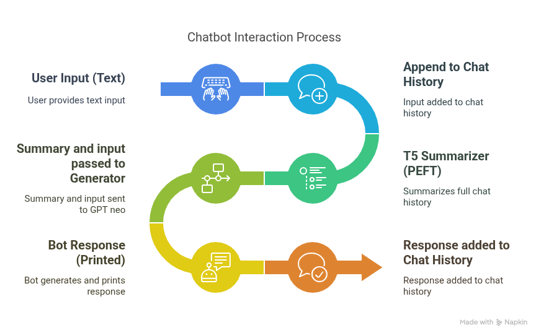
HOW THE CHATBOT WORKS – STEP-BY-STEP

Slide 27
INDIVIDUAL CONTRIBUTION
Karthik - 2101AI21
Dataset preparation, ground truth summary generation using ollama
Chatbot creation
Sainadh - 2101CS77
Experimented with zero one and few shot prompts
Applied PEFT Prompt Tuning
Chatbot creation
Anudeep - 2101AI43
Fine tune T5 base model and applied LORA on T5 model
Varshith - 2101AI28
Integrated LoRA T5 with GPT NEO for chatbot

Slide 28
THANK YOU

